Slide 1
BOOTSTRAP CARD OVERVIEW
NAME: YOUR NAME DATE: SEPTEMBER - 2024

Slide 2
WHAT IS A BOOTSTRAP CARD?
PURPOSE
COMPONENTS
FLEXIBILITY
Bootstrap cards are versatile containers used to display various types of content such as images, text, links, etc. They provide a structured and visually appealing way to present information on websites.
A Bootstrap card typically consists of a header, body, and footer sections. The header can include a title or image, the body contains the main content, and the footer may have additional details or interactive elements.
Bootstrap cards are responsive by default, meaning they adapt well to different screen sizes. They can be easily customized with CSS to match the design aesthetics of a website.

Slide 3
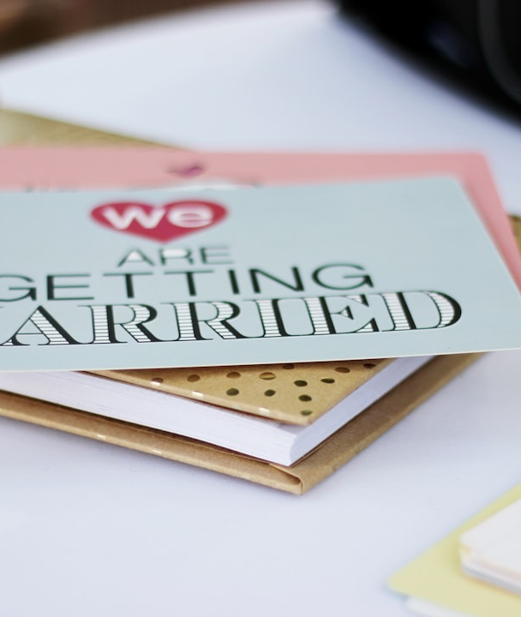
CREATING A BOOTSTRAP CARD
STEP-BY-STEP GUIDE
To create a Bootstrap card, start by including the necessary Bootstrap CSS and JS files in your project. Then, use the card component class in your HTML code with specific elements for header, body, and footer. Finally, customize the card's content and styling as needed.

Slide 4


CARD STRUCTURE
BODY AND FOOTER
The body section holds the main content of the card, such as text, images, or buttons. The footer can include additional information, metadata, or actions related to the card's content.
HEADER
The header of a Bootstrap card typically contains the card title or any introductory information. It is placed at the top of the card and often includes an image or icon.

Slide 5
CARD EXAMPLES
30%
25%
20%
25%
PRODUCT CARD
ARTICLE CARD
EVENT CARD
PROFILE CARD
An example of a Bootstrap card used in e-commerce websites to showcase product details, pricing, and images.
Bootstrap cards are widely used in blog websites to present articles with featured images, titles, and a short description.
Event websites often use Bootstrap cards to showcase event details, date, location, and ticket information in a visually appealing format.
A common use of Bootstrap cards in social networks to display user profiles, including profile pictures, bio information, and social links.

Slide 6
CUSTOMIZING CARDS
CONTENT
You can customize the content of Bootstrap cards by adding images, text, links, buttons, or any other HTML elements inside the card components. This flexibility enables creative presentations of information.
STYLING
Bootstrap cards can be customized using CSS to change colors, fonts, borders, and overall design. It allows developers to match the card's appearance with the overall website theme.

Slide 7
SUMMARY: BOOTSTRAP CARD BEST PRACTICES
BEST PRACTICES | DESCRIPTION
Consistent Design | Maintain a consistent card layout and styling throughout your website for a unified user experience.
Responsive Design | Ensure that Bootstrap cards are responsive and adapt well to various devices and screen sizes.
Optimized Content | Focus on concise and relevant content within the cards to engage users effectively.
Accessibility | Make sure that card content is accessible to all users, including those using assistive technologies.

